Slide 1
PythonDS-16 Exception Handling
Dr. Naveen Kumar
Associate Professor
Amity Institute of Information Technology
Amity University Patna

Slide 2
Understanding Exceptions and Syntax Errors
>>> print(0 / 0))
File "<stdin>", line 1
print(0 / 0))
^
SyntaxError: unmatched ')'

Slide 3
>>> print(0 / 0)
Traceback (most recent call last):
File "<stdin>", line 1, in <module>
ZeroDivisionError: division by zero

Slide 4
Raising an Exception in Python
number = 10
if number > 5:
raise Exception(f"The number should not exceed 5. ({number=})")
print(number)
Traceback (most recent call last):
File "./low.py", line 3, in <module>
raise Exception(f"The number should not exceed 5. ({number=})")
Exception: The number should not exceed 5. (number=10)

Slide 5
Debugging During Development With assert
number = 1
assert (number < 5), f"The number should not exceed 5. ({number=})"
print(number)
$ python low.py
Traceback (most recent call last):
File "./low.py", line 2, in <module>
assert (number < 5), f"The number should not exceed 5. ({number=})"
^^^^^^^^^^
AssertionError: The number should not exceed 5. (number=10)

Slide 6
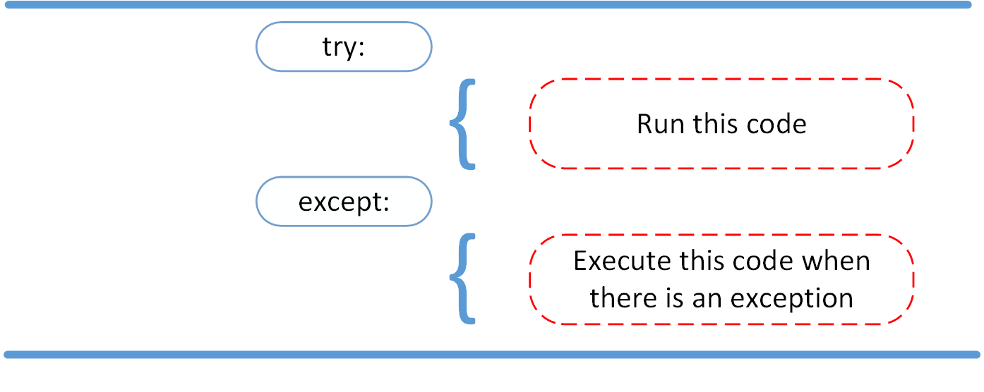
Handling Exceptions With the try and except Block

Slide 7
def linux_interaction():
import sys
if "linux" not in sys.platform:
raise RuntimeError("Function can only run on Linux systems.")
print("Doing Linux things.")
try:
linux_interaction()
except:
pass

Slide 8
try:
linux_interaction()
except:
print("Linux function wasn't executed.")

Slide 9
try:
linux_interaction()
except RuntimeError as error:
print(error)
print("The linux_interaction() function wasn't executed.")

Slide 10
try:
with open("file.log") as file:
read_data = file.read()
except:
print("Couldn't open file.log")
If file.log doesn’t exist, then this block of code will output the following:

Slide 11
try:
with open("file.log") as file:
read_data = file.read()
except FileNotFoundError as fnf_error:
print(fnf_error)
In this case, if file.log doesn’t exist, then the output will be the following:

Slide 12
try:
linux_interaction()
with open("file.log") as file:
read_data = file.read()
except FileNotFoundError as fnf_error:
print(fnf_error)
except RuntimeError as error:
print(error)
print("Linux linux_interaction() function wasn't executed.")

Slide 13
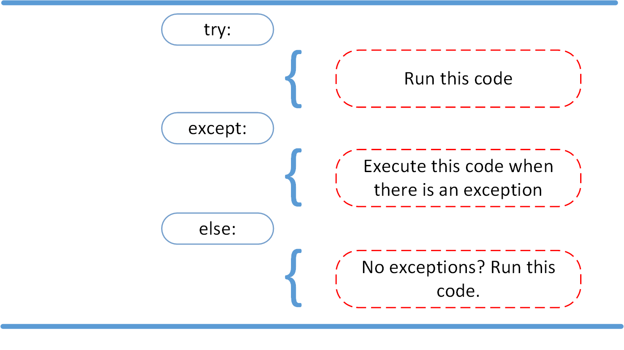
Proceeding After a Successful Try With else

Slide 14
try:
linux_interaction()
except RuntimeError as error:
print(error)
else:
print("Doing even more Linux things.")

Slide 15
try:
linux_interaction()
except RuntimeError as error:
print(error)
print("Doing even more Linux things.")

Slide 16
try:
linux_interaction()
except RuntimeError as error:
print(error)
else:
try:
with open("file.log") as file:
read_data = file.read()
except FileNotFoundError as fnf_error:
print(fnf_error)

Slide 17
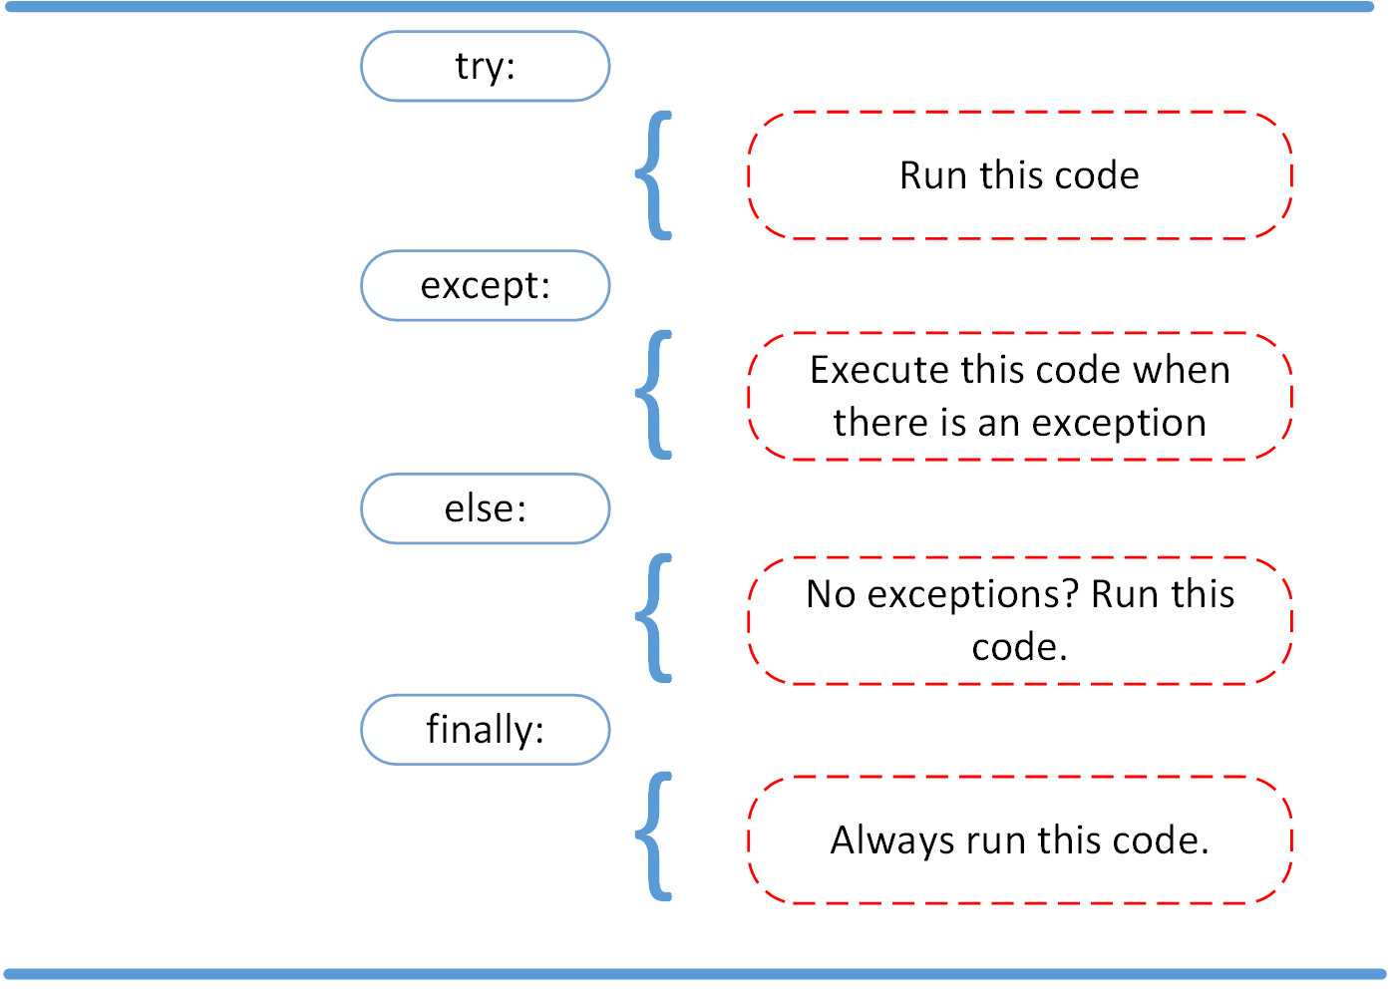
Cleaning Up After Execution With finally

Slide 18
try:
linux_interaction()
except RuntimeError as error:
print(error)
else:
try:
with open("file.log") as file:
read_data = file.read()
except FileNotFoundError as fnf_error:
print(fnf_error)
finally:
print("Cleaning up, irrespective of any exceptions.")

Slide 19
try:
linux_interaction()
finally:
print("Cleaning up, irrespective of any exceptions.")

Slide 20
Creating Custom Exceptions in Python
def linux_interaction():
import sys
if "linux" not in sys.platform:
raise RuntimeError("Function can only run on Linux systems.")
print("Doing Linux things.")
class PlatformException(Exception):
"""Incompatible platform."""
# ...

Slide 21
class PlatformException(Exception):
"""Incompatible platform."""
def linux_interaction():
import sys
if "linux" not in sys.platform:
raise PlatformException("Function can only run on Linux systems.")
print("Doing Linux things.")
# ...

Slide 22
Syntax Errors:
The errors which occur because of invalid syntax are called syntax errors.
Runtime Errors:
Also known as exceptions.
While executing the program if something goes wrong because of end user input or
programming logic or memory problems etc then we will get Runtime Errors.

Slide 23
Exception Handling
Exception Handling concept applicable for Runtime Errors but not for syntax errors
An unwanted and unexpected event that disturbs normal flow of program is called
exception.
Eg:
ZeroDivisionError
TypeError
ValueError
FileNotFoundError
EOFError
SleepingError
TyrePuncturedError

Slide 24
The main objective of exception handling
is smooth executiong and Termination of the program (i.e we should not block our resources and we should not miss anything)
Exception handling does not mean repairing/correcting exception. We have to define alternative way to continue rest of the program normally.
Eg: For example our programming requirement is reading data from remote file. At runtime if file is not available then the program should not be
terminated abnormally. We have to provide some alternative file to continue rest of the program
normally. This way of defining alternative is nothing but exception handling.

Slide 25
Default Exception Handing in Python
Every exception in Python is an object. For every exception type the corresponding exception classes are available.
Whenever an exception occurs, PVM will create the corresponding exception object and will check for handling the code.
If handling code is not available then Python interpreter terminates the program abnormally and prints the corresponding exception information to the console.
The rest of the program won't be executed. AKA Abnormal Termination.

Slide 27
Every Exception in Python is a class.
All exception classes are child classes of BaseException.i.e every exception class extends BaseException either directly or indirectly.
Hence BaseException acts as root for Python Exception Hierarchy.
Most of the times being a programmer we have to concentrate Exception and its child classes.

Slide 28
Customized Exception Handling by using try-except
It is highly recommended to handle exceptions.
The code which may raise exception is called risky code and we have to take risky code inside try block.
The corresponding handling code we have to take inside except block.
try:
Risky Code
except XXX:
Handling code/Alternative Code

Slide 29
print("stmt-1")
print(10/0)
print("stmt-3")
print("stmt-1")
try:
print(10/0)
exceptZeroDivisionError:
print(10/2)
print("stmt-3")

Slide 30
Control Flow in try-except
try:
state1
state2
state3
except:
state4
state5

Slide 31
Case-1: If there is no exception
1,2,3,5 and Normal Termination
Case-2: If an exception raised at stmt-2 and corresponding except block matched
1,4,5 Normal Termination
Case-3: If an exception rose at stmt-2 and corresponding except block not matched
1, Abnormal Termination
Case-4: If an exception rose at stmt-4 or at stmt-5 then it is always abnormal
termination.

Slide 32
Within the try block if anywhere exception raised then rest of the try block won’t be
executed eventhough we handled that exception. Hence we have to take only risky
code inside try block and length of the try block should be as less as possible.
In addition to try block, there may be a chance of raising exceptions inside except and
finally blocks also.
If any statement which is not part of try block raises an exception then it is always
abnormal termination.

Slide 33
Print Exception Information
try:
print(10/0)
Except ZeroDivisionErroras msg:
print("exception raised and its description is:", msg)
Output exception raised and its description is: division by zero

Slide 34
try with Multiple except Blocks
The way of handling exception is varied from exception to exception.Hence for every
exception type a seperate except block we have to provide. i.e try with multiple except
blocks is possible and recommended to use.
try:
----
----
----
except ZeroDivisionError:
perform alternative arithmetic operations
except FileNotFoundError:
use local file instead of remote file

Slide 35
If try with multiple except blocks available then based on raised exception the corresponding except block will be executed.
try:
x=int(input("Enter First Number: "))
y=int(input("Enter Second Number: "))
print(x/y)
exceptZeroDivisionError:
print("Can't Divide with Zero")
exceptValueError:
print("please provide int value only")

Slide 36
If try with multiple except blocks available then the order of these except blocks is important .Python interpreter will always consider from top to bottom until matched except block identified.
try:
x=int(input("Enter First Number: "))
y=int(input("Enter Second Number: "))
print(x/y)
exceptArithmeticError:
print("ArithmeticError")
exceptZeroDivisionError:
print("ZeroDivisionError")

Slide 37
Single except Block that can handle Multiple Exceptions
We can write a single except block that can handle multiple different types of exceptions.
except (Exception1,Exception2,exception3,..): OR
except (Exception1,Exception2,exception3,..) as msg :
Parentheses are mandatory and this group of exceptions internally considered as tuple.
1) try:
2) x=int(input("Enter First Number: "))
3) y=int(input("Enter Second Number: "))
4) print(x/y)
5) except (ZeroDivisionError, ValueError) as msg:
6) print("Plz Provide valid numbers only and problem is: ",msg)

Slide 38
Default except Block
We can use default except block to handle any type of exceptions.
In default except block generally we can print normal error messages.
Syntax:
except:
statements
1) try:
2) x=int(input("Enter First Number: "))
3) y=int(input("Enter Second Number: "))
4) print(x/y)
5) except ZeroDivisionError:
6) print("ZeroDivisionError:Can't divide with zero")
7) except:
8) print("Default Except:Plz provide valid input only")

Slide 39
If try with multiple except blocks available then default except block should be last, otherwise we will get SyntaxError.
1) try:
2) print(10/0)
3) except:
4) print("Default Except")
5) except ZeroDivisionError:
6) print("ZeroDivisionError")
SyntaxError: default 'except:' must be last
Note: The following are various possible combinations of except blocks
1) except ZeroDivisionError:
2) except ZeroDivisionError as msg:
3) except (ZeroDivisionError, ValueError) :
4) except (ZeroDivisionError, ValueError) as msg:
5) except :

